Slide 1
Virtual Colloquium on Opportunities in Mobile Application Development Industry in South Africa
Mixo Ngoveni - Geekulcha

Slide 2
Notes:
Introduction

Slide 3
Meet Geekulcha
Geekulcha is where young, skilled, creative and ambitious tech minds meet to connect with each other, share knowledge, collaborate on projects, network with industry leaders, obtain training to further improve and enhance their skills and to put those newly acquired skills to work.
Established 15 March 2013, our focus is on empowering young geeks through ICT skills development and training while giving them a taste of what awaits them in the big world through industry exposure.
The ultimate goal is to ensure that the South African tech ecosystem is competitive and as the geeks build cool technological solutions, there is wherever possible an element of sustainability.
Notes:
About Geekulcha - Give overview

Slide 4
Mpumalanga
North West
Limpopo
2015 - present Localised entrepreneurship
- GKSS-TUT Emalahleni
- GKSS-UMP Nelspruit (HIV/AIDS)
- Digital Literacy For Development
- Geekulcha VacWork programme
2015 - present Digital entrepreneurship
- GKSS-NWU Mahikeng
- Digital Literacy For Development
- STEM Careers programmes
2014 - present Digital education
- Giyani High School Geekulcha visit
- Geekulcha VacWork programme
- GKSS-Waterberg Lebowakgomo
- Thagaetala STEM Careers and EXPO
Gauteng
Northern Cape
2013 - present Geekulcha HQ - where it all began
- GKSS-VUT Vanderbijlpark
- GKSS-TUT Soshanguve
- GKSS-RGIT Pretoria
- GKSS-RC Braamfontein
- GKSS-TNC Mamelodi
- Geekulcha Annual Hackathon
- Information Security Hackathons
- Youth ICT and Business VacWork
2015 - present Localised geek culture
- NCDev Ecosystem
- GKSS-SPU Kimberley
- SkateHacks initiative
- Digital Literacy For Development
- mLab South Africa
Free State
KwaZulu-Natal
2019 - present Civic tech engagements
- GKSS-CUT Welkom
- GKSS-CUT Bloemfontein
- Digital Literacy For Development
- Budget Dataquest (National Treasury)
2014 - present Digitising the Evolution
- Digital Literacy For Development
- Youth ICT and Business VacWork
- Budget Data Hackathon
Eastern Cape
Western Cape
2015 - present Digital Smart Citizenship
- Digital Literacy For Development
- Budget Dataquest (National Treasury)
- Women Hackathon
2015 - Present Public sector innovation
- GKSS-CPUT Cape Town
- Public Sector Innovation Hackathon
- Digital Literacy For Development
Notes:
Touch on the reach of Geekulcha

Slide 5
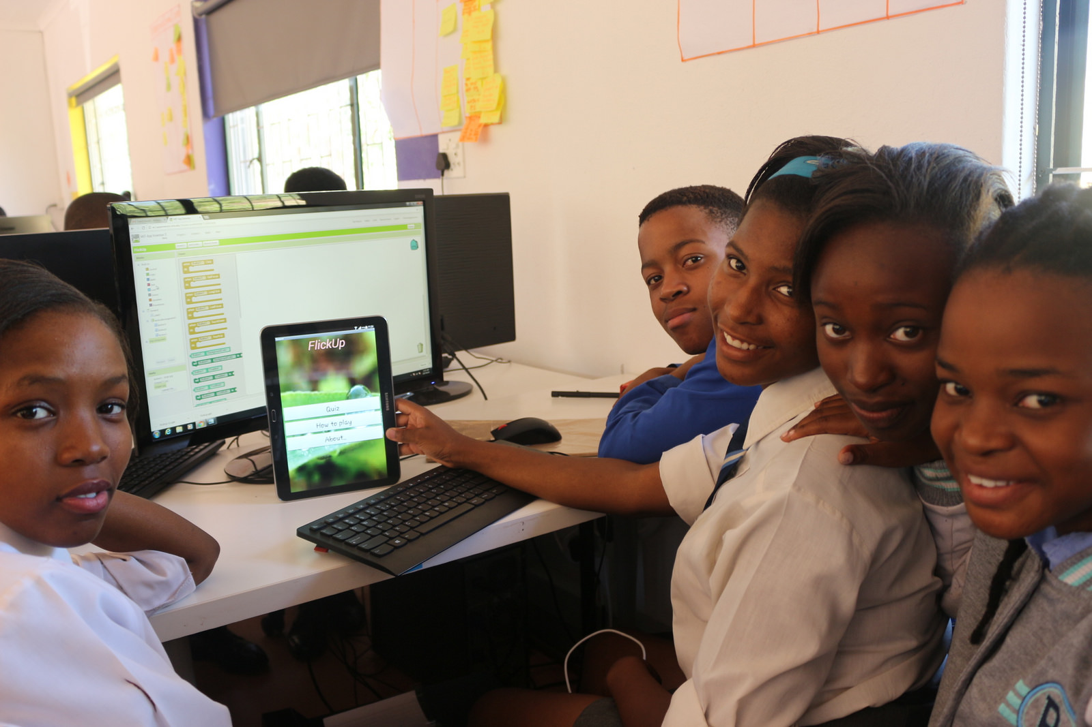
Notes:
Great progress and strides from High School

Slide 6
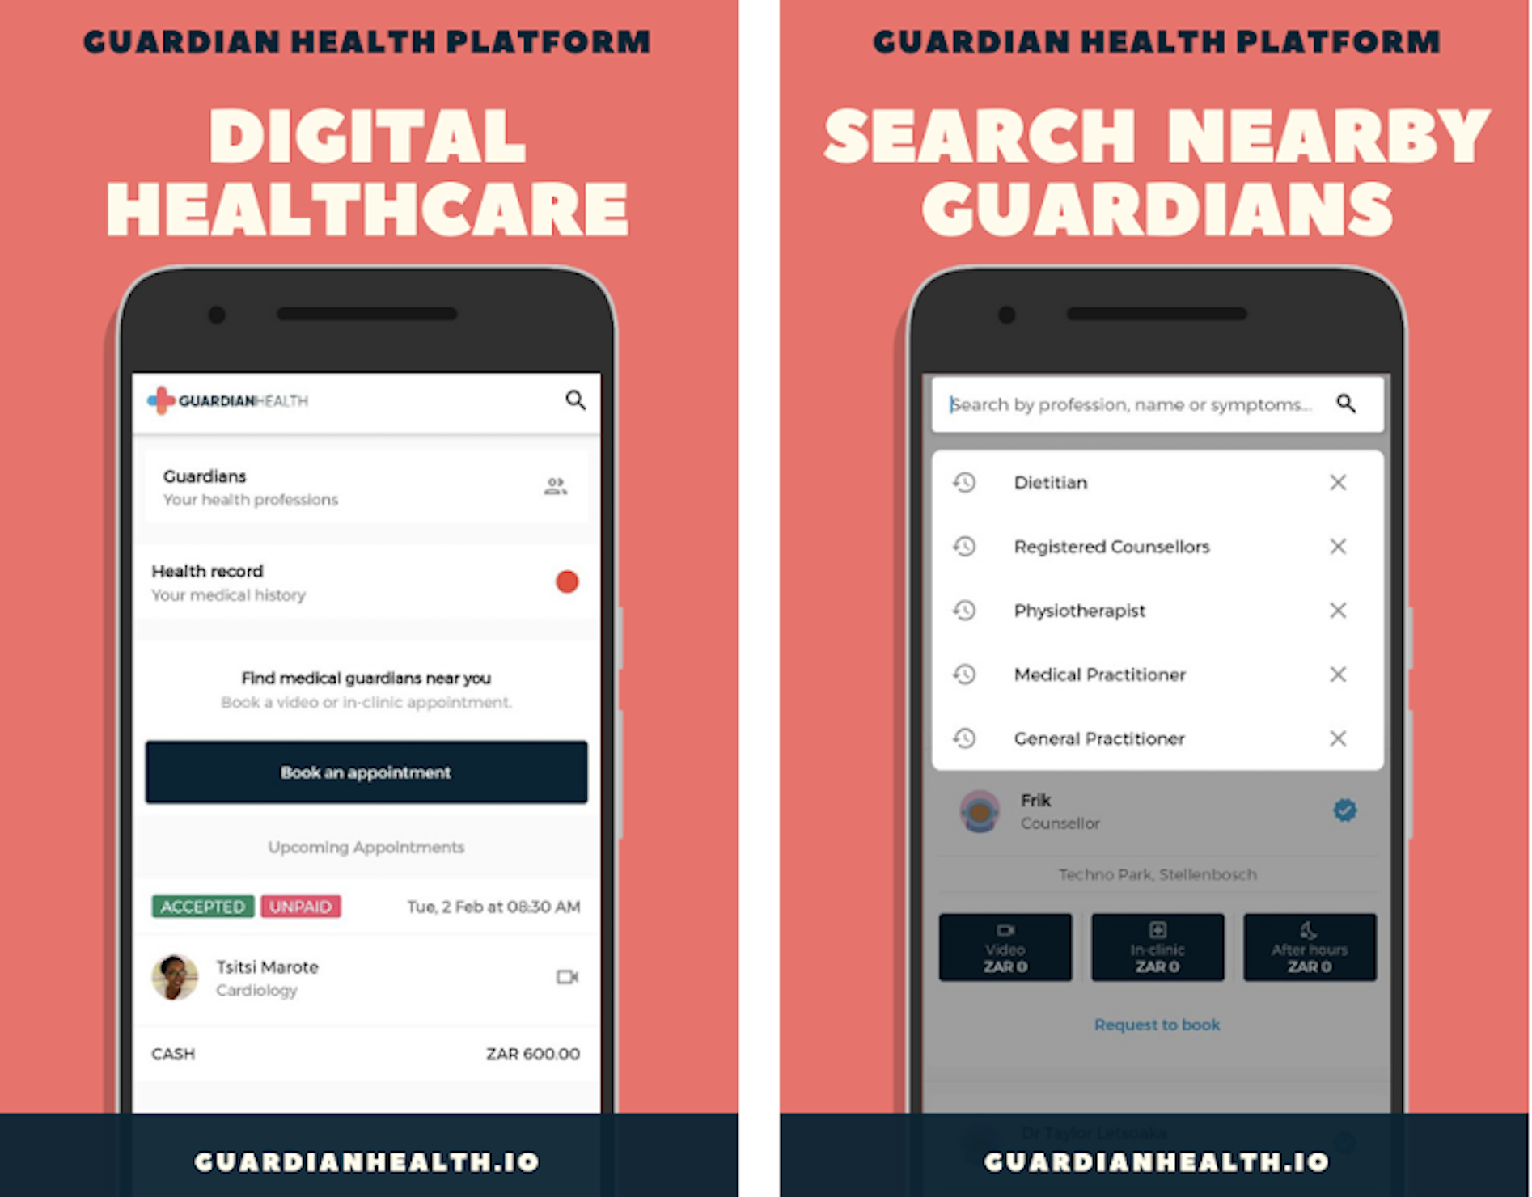
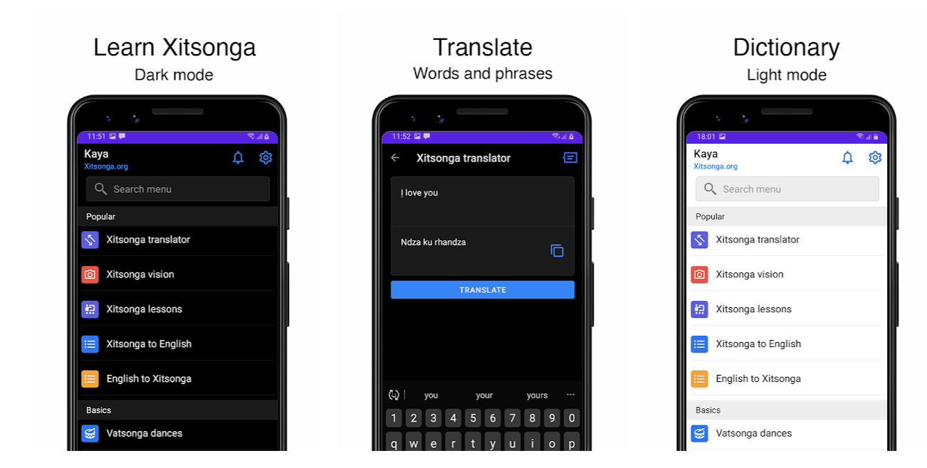
Notes:
Great examples: From Idea phase to market

Slide 7
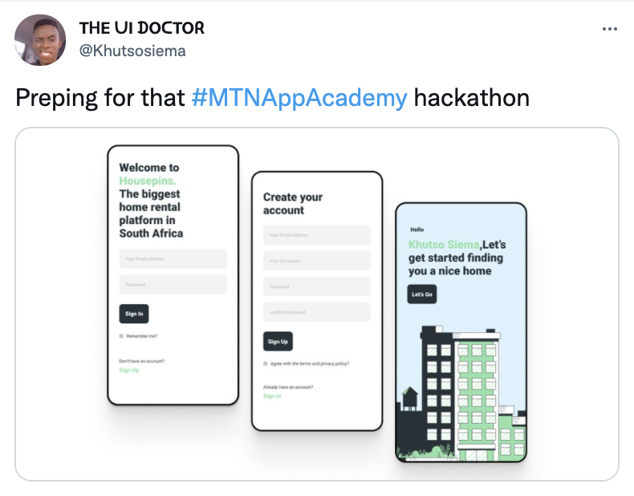
MTN Business App Academy
3000 Applicants for 2021
2669 Taking part in the App Academy
Representation across all 9 Provinces
Notes:
Work Done by MTN Business

Slide 8
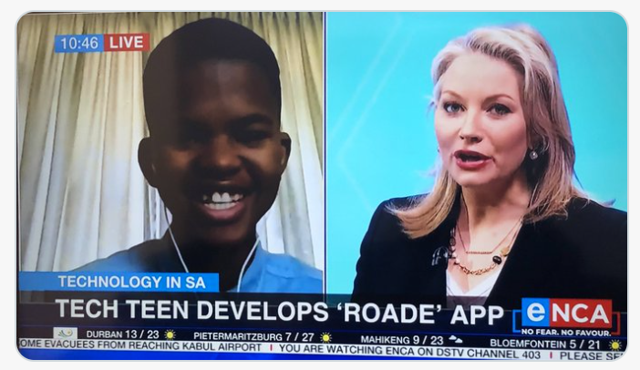
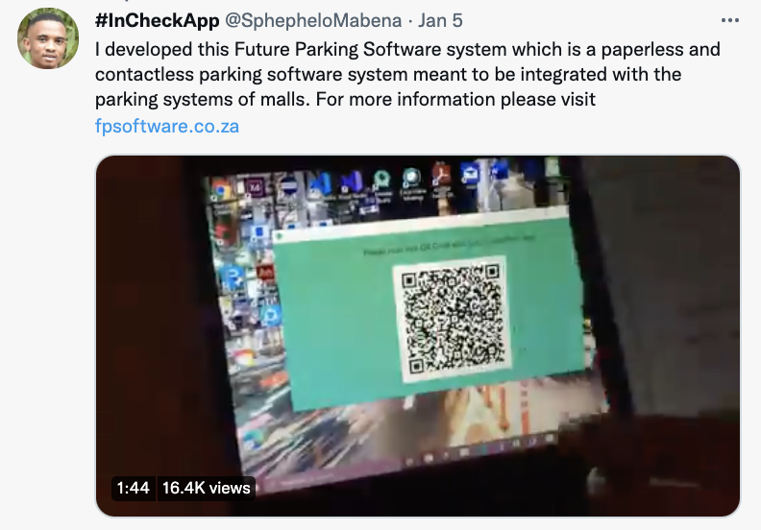

Slide 9
Challenges
Business Development
Pricing knowledge of apps
Learn how to do proper research
Build with users in mind
Go to market plans
Startup Resources
MARKETPLACE for App Developers

Slide 10
Unit 9 Ground Floor
16 Pieter Street
Highveld Techno Park
Centurion 0169
📩 info@geekulcha.com 💻 www.geekulcha.dev
https://www.facebook.com/Geekulcha
https://www.twitter.com/Geekulcha
https://www.instagram.com/Geekulcha

